Slide 1




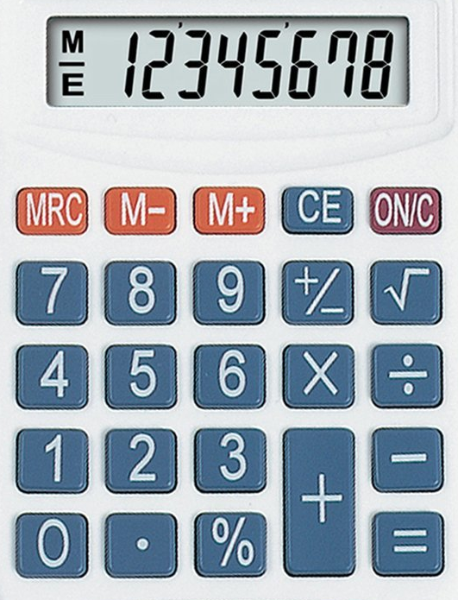
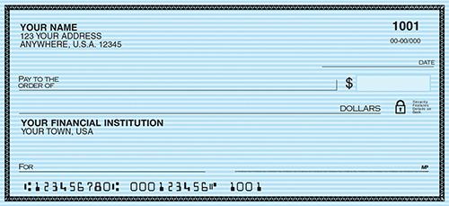
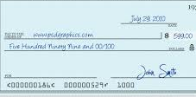




















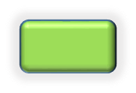


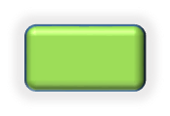



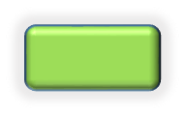
Deposit
PMA Checking
Checking
Savings
Get $200
PMA Checking
Checking
Savings
Get Cash
PMA Checking
Checking
Savings
$20
$40
$60
$80
$100
$120
$140
$160
$180
$200
View Balance
PMA Checking
Checking
Savings
Donate to Charity
$5
$10
$25
$50
$100
PMA Checking
Checking
Savings
$0.00

Slide 2


Check 825 in the amount of $245.00 deposited to Savings. Remaining Balance is $12,250.00
$200 Withdrawn from PMA Checking. Remaining Balance is $23,456.89
PMA Checking balance is $23,456.89, monthly spend $2500.00 over last 12 months
Savings balance is $12,250.00, monthly spend is $0.00 over last 12 months
Checking balance is $50,000.00, monthly spend $4500.00 over last 12 months

